Slide 1
Principle of marketing
.

Slide 2


Slide 3





Slide 4

Market Philosophy

Slide 5

What are they selling?
Who are they selling to?

Slide 6
..
How are they sourcing the product?
Services in-house.
Marketing Management Orientation of the Company
Societal orientation.
Current Business Portfolio
Do not currently have but serving Internationally and locally.

Slide 7
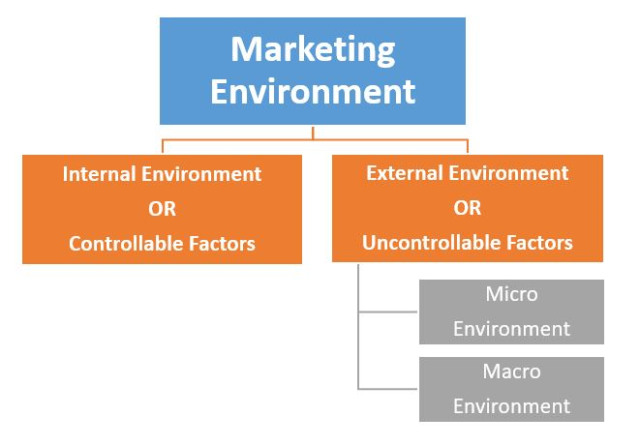

Slide 8

COMPETITIVE MARKET ANALYSIS
v8 digital solutions
Angel Brackets

Slide 9
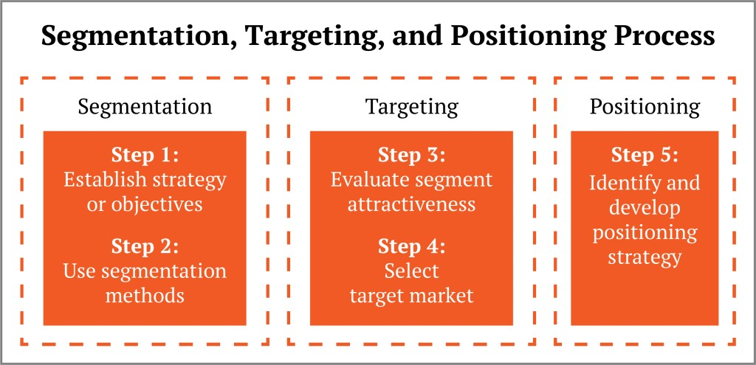
Target Market & Market Segmentation of the Company

Slide 10
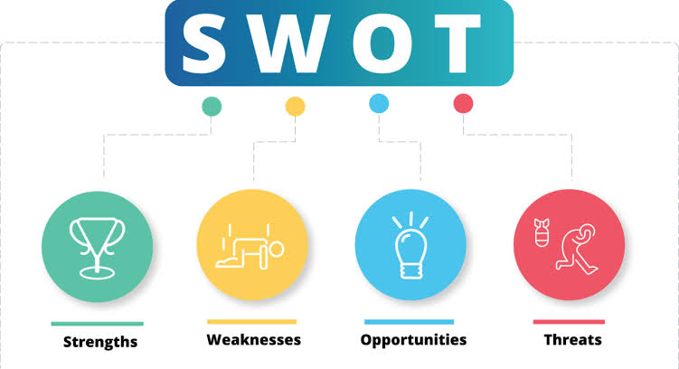

Slide 11
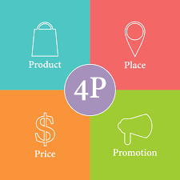
MARKETING MIX OF THE COMPANY
Product Quality
Branding
Packaging
Labelling
Product mix & Product line decisions

Slide 12
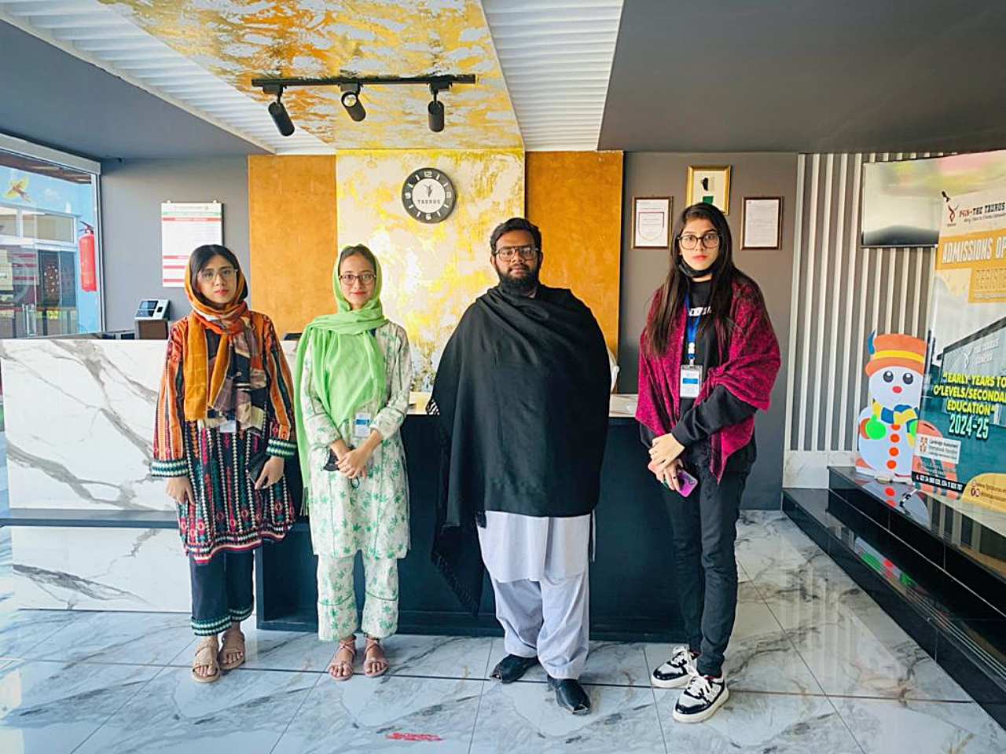

Slide 13
THANKYOU! https://taurosync.com Facebook: https://www.facebook.com/Taurosync Instagram: https://www.instagram.com/taurosync/ LinkedIn: https://www.linkedin.com/company/taurosync/

